Slide 1
Transmission Control Protocol (TCP)
Copyright © The McGraw-Hill Companies, Inc. Permission required for reproduction or display.

Slide 2
15-6 WINDOWS IN TCP
TCP uses two windows (send window and receive window) for each direction of data transfer.

Slide 3
Send Window
The window used here is of size 100 bytes (normally thousands of bytes)
The send window size is dictated by the receiver (flow control) and the congestion in the underlying network (congestion control).
The figure shows how a send window opens, closes, or shrinks.

Slide 4
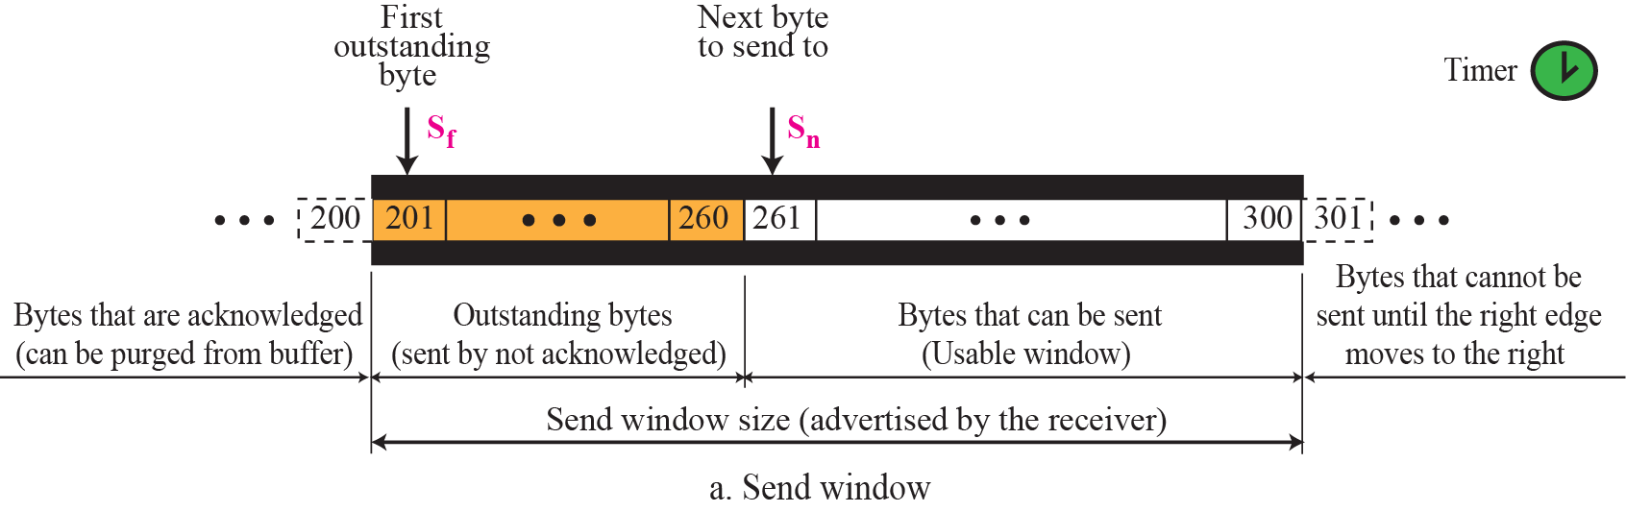
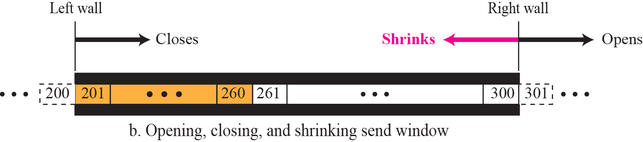
Figure 15.22 Send window in TCP

Slide 5
Receive Window
The window used is of size 100 bytes (normally thousands of bytes).
The figure also shows how the receive window opens and closes;
in practice, the window should never shrink.

Slide 6
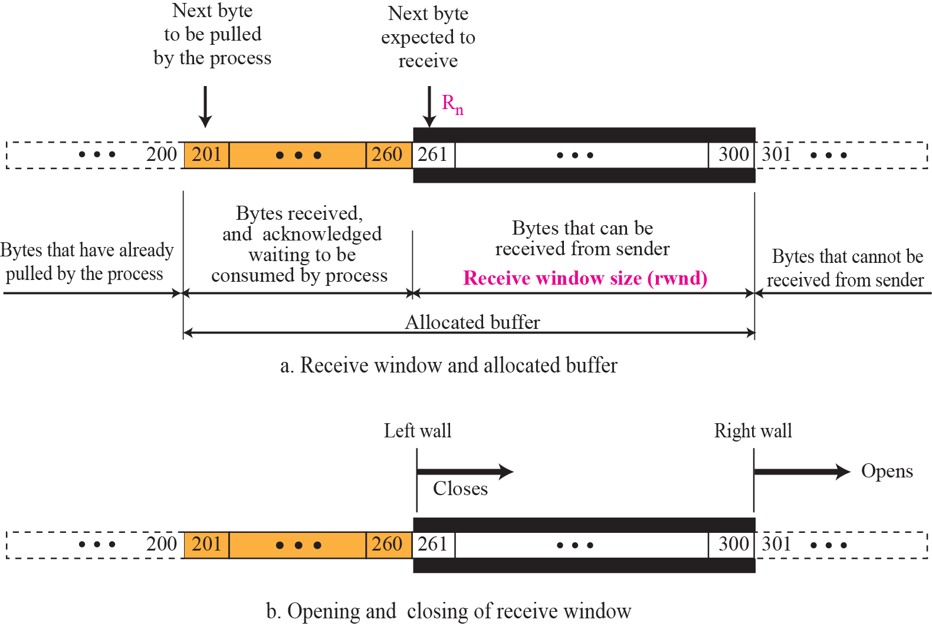
Figure 15.23 Receive window in TCP

Slide 7
15-7 FLOW CONTROL
Flow control balances the rate a producer creates data with the rate a consumer can use the data.
TCP separates flow control from error control.
Temporarily assume that the logical channel between the sending and receiving TCP is error-free.
Figure shows unidirectional data transfer between a sender and a receiver;
bidirectional data transfer can be deduced from unidirectional one.

Slide 8
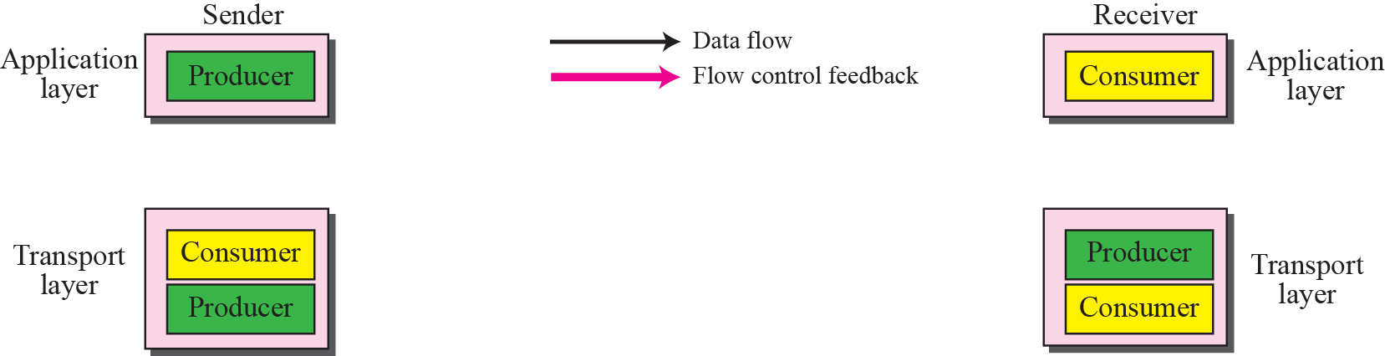
Figure 15.24 TCP/IP protocol suite

Slide 9
Figure 15.24 TCP/IP protocol suite
Data travel from the sending process down to the sending TCP, from the sending TCP to the receiving TCP, and from receiving TCP up to the receiving process (paths 1, 2, and 3).
Flow control feedbacks, are traveling from the receiving TCP to the sending TCP and from the sending TCP up to the sending process (paths 4 and 5).
The receiving TCP controls the sending TCP; the sending TCP controls the sending process.
Flow control feedback from the sending TCP to the sending process (path 5) is
achieved through simple rejection of data by sending TCP when its window is full.
Here discussion of flow control concentrates on the feedback sent from the receiving TCP to the sending TCP (path 4).

Slide 10
Opening and Closing Windows
To achieve flow control, TCP forces the sender and the receiver to adjust their window sizes, although the size of the buffer for both parties is fixed when the connection is established.
The receive window
closes (moves its left wall to the right) when more bytes arrive from the sender;
it opens (moves its right wal l to the right) when more bytes are pulled by the process.
We assume that it does not shrink (the right wall does not move to the left).
The opening, closing, and shrinking of the send window is controlled by the receiver.
The send window
closes (moves its left wall to the right) when a new acknowledgement allows it to do so.
opens (its right wall moves to the right) when the receive window size (rwnd) advertised by the receiver allows it to do so.
shrinks on occasion. We assume that this situation does not occur.

Slide 11
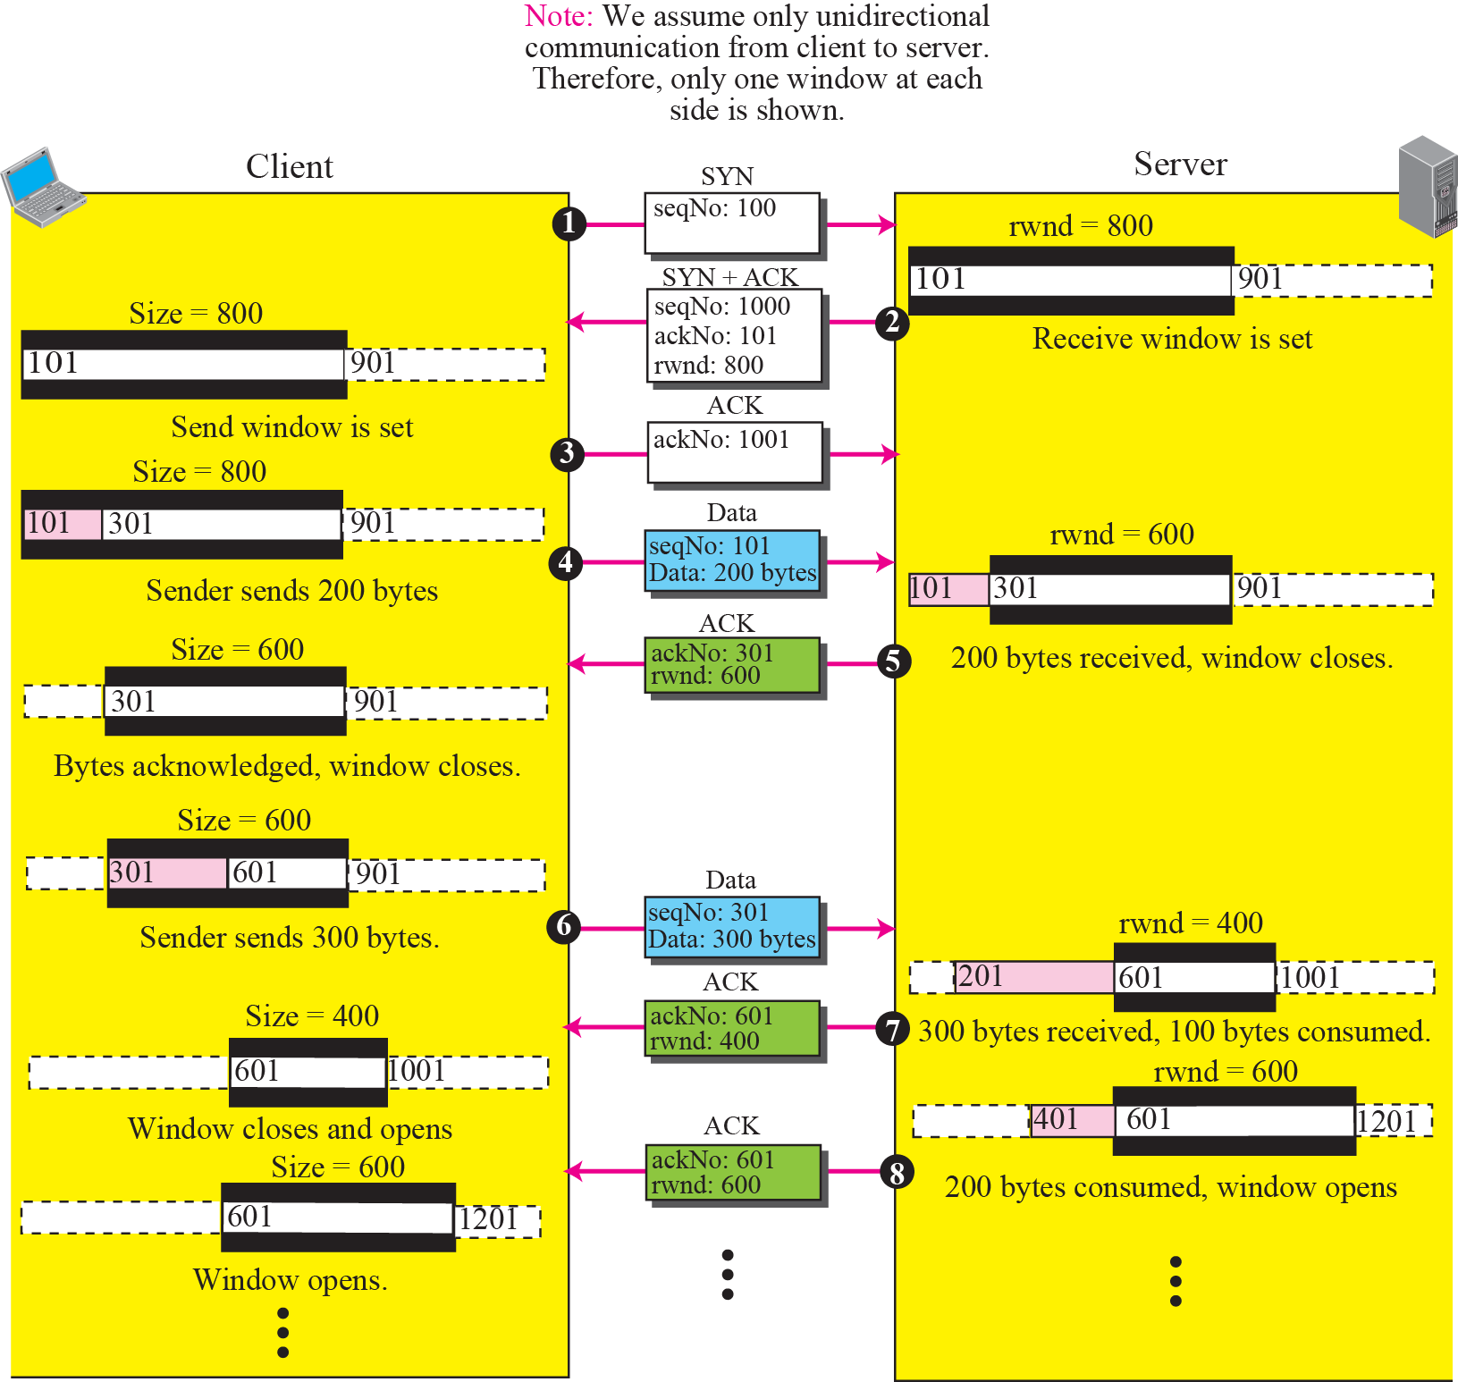
Figure 15.25 An example of flow control

Slide 12

Figure 15.25 An example of flow control
Shrinking of Windows
The receive window cannot shrink.
send window can shrink if the receiver defines a value for rwnd that results in shrinking the window.
Some implementations do not allow the shrinking of the send window.
the receiver needs to keep the following relationship between the last and new acknowledgment and the last and new rwnd values to prevent the shrinking of the send window:
The relationship shows that the right wall should not move to the left.

Slide 13
Example 15.2
Part a : values of last acknowledgment and rwnd.
Part b : sender has sent bytes 206 to 214. Bytes 206 to 209 are acknowledged and purged.
new advertisement defines the new value of rwnd as 4, in which 210 + 4 < 206 + 12.
When the send window shrinks, it creates a problem: byte 214 which has been already sent is outside the window.
One way to prevent this situation is to let the receiver postpone its feedback until enough buffer locations are available in its window.
In other words, the receiver should wait until more bytes are consumed by its process.

Slide 14
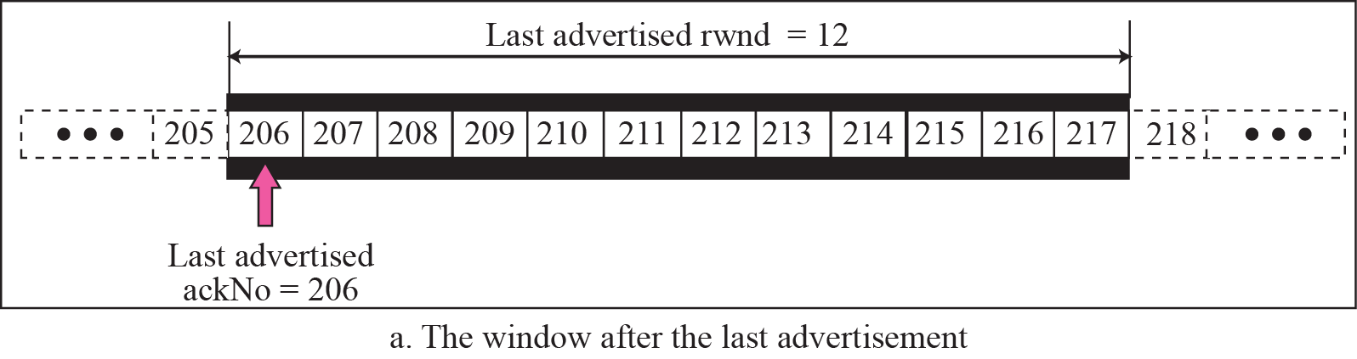
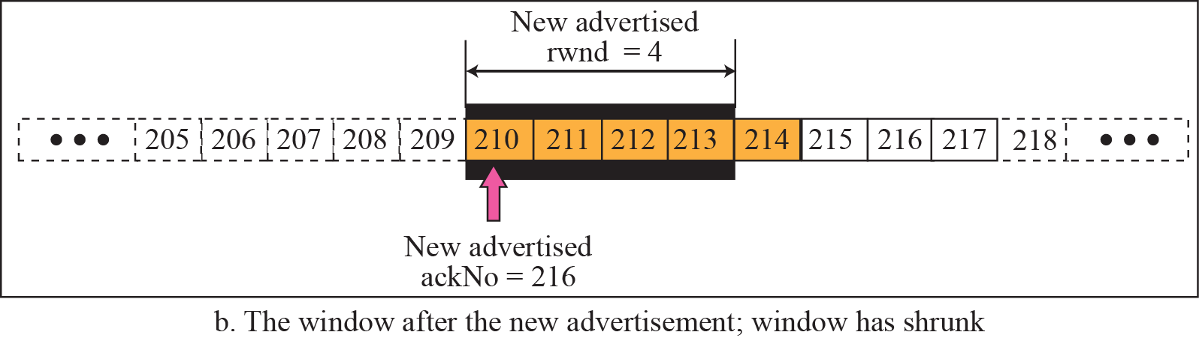
sender has sent bytes 206 to 214. Bytes 206 to 209 are acknowledged and purged.
Figure 15.26
Prevent the shrinking of the send window:
new ackNo + new rwnd >= last ackNo + last rwnd
?
210
210 + 4 < 206 + 12.

Slide 15
Window Shutdown
Shrinking the send window by moving its right wall to the left is strongly discouraged.
There is one exception: the receiver can temporarily shut down the window by sending a rwnd of 0.
This can happen when receiver does not want to receive any data from the sender for a while.
In this case, the sender does not actually shrink the size of the window, but stops sending data until a new advertisement has arrived.

Slide 16
Silly Window Syndrome
A serious problem can arise in sliding window operation when either sending application program creates data slowly or receiving application program consumes data slowly, or both.
Any of these situations results in the sending of data in very small segments, which reduces the efficiency of the operation.
if TCP sends segments containing only 1 byte of data, it means that a 41-byte datagram (20 bytes of TCP header and 20 bytes of IP header) transfers only 1 byte of user data.
Here overhead is 41/1, which indicates that we are using the capacity of network very inefficiently.
This problem is called the silly window syndrome.

Slide 17
Syndrome Created by the Sender
sending TCP may create a silly window syndrome if it is serving an application program that creates data slowly, for example, 1 byte at a time.
Application program writes 1 byte at a time into the buffer of sending TCP. If the sending TCP does not have any specific instructions, it may create segments containing 1 byte of data.
The result is a lot of 41-byte segments that are traveling through an internet.
The solution is to prevent the sending TCP from sending the data byte by byte.
Sending TCP must be forced to wait and collect data to send in a larger block.
How long should the sending TCP wait? If it waits too long, it may delay the process.
If it does not wait long enough, it may end up sending small segments.
Nagle found an elegant solution.

Slide 18
Nagle’s Algorithm Nagle’s algorithm
Sending TCP sends the first piece of data it receives from the sending application program even if it is only 1 byte.
2. After sending first segment, sending TCP accumulates data in output buffer and waits until either receiving TCP sends an acknowledgment or until enough data has accumulated to fill a maximum-size segment. At this time, the sending TCP can send the segment.
3. Step 2 is repeated for the rest of the transmission. Segment 3 is sent immediately if an acknowledgment is received for segment 2, or if enough data have accumulated to fill a maximum-size segment.
Nagle’s algorithm:
simplicity
it takes into account the speed of the application program that creates the data and the speed of the network that transports the data.
If the application program is faster than the network, segments are larger.
If the application program is slower than the network, the segments are smaller.

Slide 19
Syndrome Created by the Receiver
Receiving TCP may create a silly window syndrome if it is serving an application program that consumes data slowly, for example, 1 byte at a time.
Suppose that sending application program creates data in blocks of 1 kilobyte, but the receiving application program consumes data 1 byte at a time.
Also suppose that the input buffer of the receiving TCP is 4 kilobytes. The sender sends the first 4 kilobytes of data. The receiver stores it in its buffer. Now its buffer is full. It advertises a window size of zero, which means the sender should stop sending data. The receiving application reads the first byte of data from the input buffer of the receiving TCP. Now there is 1 byte of space in the incoming buffer. The receiving TCP announces a window size of 1 byte. Sending TCP takes this advertisement and sends a segment carrying only 1 byte of data. The procedure will continue.
One byte of data is consumed and a segment carrying 1 byte of data is sent. Again we have an efficiency problem and the silly window syndrome.

Slide 20
Two solutions have been proposed
Clark’s Solution
send an acknowledgment as soon as the data arrive, but to announce a window size of zero until either there is enough space to accommodate a segment of maximum size or until at least half of the receive buffer is empty.

Slide 21
Delayed Acknowledgment
The second solution is to delay sending the acknowledgment. This means that when a segment arrives, it is not acknowledged immediately. The receiver waits until there is a decent amount of space in its incoming buffer before acknowledging the arrived segments. The delayed acknowledgment prevents the sending TCP from sliding its window.
It also reduces traffic. Receiver does not have to acknowledge each segment.
Disadvantage : Delayed acknowledgment may result in the sender unnecessarily retransmitting the unacknowledged segments.
TCP balances the advantages and disadvantages. It now defines that the acknowledgment should not be delayed by more than 500 ms.

Slide 22
15-8 ERROR CONTROL
TCP is a reliable transport layer protocol.
To deliver the entire stream of data in order, without error, and without any part lost or duplicated.
TCP provides reliability using error control.
Error control includes
mechanisms for detecting and resending corrupted segments,
resending lost segments,
storing out-of order segments until missing segments arrive
detecting and discarding duplicated segments.
Error control is achieved using 3 tools: checksum, acknowledgment, and time-out.

Slide 23
Checksum
Each segment includes a checksum field, which is used to check for a corrupted segment.
If a segment is corrupted, the segment is discarded by the destination TCP and is considered as lost.
TCP uses a 16-bit checksum that is mandatory in every segment.

Slide 24
Acknowledgment
TCP uses acknowledgments to confirm the receipt of data segments.
Control segments that carry no data, but consume a sequence number, are also acknowledged.
ACK segments are never acknowledged.

Slide 25

Note
ACK segments do not consume sequence numbers and
are not acknowledged.

Slide 26
Acknowledgment Type
In the past, TCP used only one type of acknowledgment: cumulative acknowledgment.
Today, some TCP implementations also use selective acknowledgment.
Cumulative Acknowledgment (ACK)
TCP was originally designed to acknowledge receipt of segments cumulatively.
The receiver advertises the next byte it expects to receive, ignoring all segments received and stored out of order.
This is sometimes referred to as positive cumulative acknowledgment or ACK.
Word “positive” indicates that no feedback is provided for discarded, lost, or duplicate segments.

Slide 27
Selective Acknowledgment (SACK)
A SACK does not replace ACK, but reports additional information to the sender.
A SACK reports a block of data that is out of order, and also a block of segments that is duplicated, i.e. received more than once.
Since there is no provision in the TCP header for adding this type of information, SACK is implemented as an option at the end of the TCP header.

Slide 28
Rules for Generating Acknowledgments
1. When end A sends a data segment to end B, it must include (piggyback) an acknowledgment that gives the next sequence number it expects to receive.
2. When the receiver has no data to send and it receives an in-order segment and the previous segment has already been acknowledged, the receiver delays sending an ACK segment until another segment arrives or until a period of time (normally 500 ms) has passed.
3. When a segment arrives with a sequence number that is expected by the receiver, and previous in-order segment has not been acknowledged, receiver immediately sends an ACK segment. In other words, there should not be more than two in-order unacknowledged segments at any time. This prevents the unnecessary retransmission of segments that may create congestion.

Slide 29
Rules for Generating Acknowledgments (contd)
4. When a segment arrives with an out-of-order sequence number that is higher than expected, the receiver immediately sends an ACK segment announcing the
sequence number of the next expected segment. This leads to fast retransmission of missing segments.
5. When a missing segment arrives, receiver sends an ACK segment to announce the next sequence number expected.
6. If a duplicate segment arrives, receiver discards the segment, but immediately sends an acknowledgment indicating the next in-order segment expected.

Slide 30
Retransmission
The heart of the error control mechanism is the retransmission of segments.
When a segment is sent, it is stored in a queue until it is acknowledged.
When the retransmission timer expires or when the sender receives three duplicate ACKs for the first segment in the queue, that segment is retransmitted.

Slide 31
Retransmission
Retransmission after RTO
Sending TCP maintains one retransmission time-out (RTO) for each connection.
When the timer matures, i.e. times out, TCP sends segment in the front of the queue (the segment with the smallest sequence number) and restarts the timer.
This version of TCP is sometimes referred to as Tahoe.
Value of RTO is dynamic in TCP and is updated based on the round-trip time (RTT) of segments.
RTT : Time needed for a segment to reach a destination and for an acknowledgment to be received.

Slide 32
Retransmission
Retransmission after Three Duplicate ACK Segments
Previous rule about retransmission of a segment is sufficient if the value of RTO is not large.
To help throughput by allowing sender to retransmit sooner, most implementations follow 3 duplicate ACKs rule and retransmit missing segment immediately.
This feature is called fast retransmission, and the version of TCP that uses this feature is referred to as Reno.
In this version, if 3 duplicate acknowledgments (i.e., an original ACK plus three exactly identical copies) arrives for a segment, the next segment is retransmitted without waiting for the time-out.

Slide 33
Out-of-Order Segments
TCP implementations today do not discard out-of-order segments.
They store them temporarily and flag them as out-of-order segments until the missing segments arrive.
Out-of-order segments are never delivered to the process.
TCP guarantees that data are delivered to the process in order.

Slide 34
Note
Data may arrive out of order and be temporarily stored by the receiving TCP,
but TCP guarantees that no out-of-order data are delivered to the process.

Slide 35
Some Scenarios
scenarios that occur during operation of TCP, considering only error control issues.
show a segment by a rectangle. If the segment carries data, we show the range of byte numbers and the value of the acknowledgment field.
If it carries only an acknowledgment, we show only the acknowledgment number in a smaller box.

Slide 36
Normal Operation
First scenario shows bidirectional data transfer between two systems.
The client TCP sends one segment; the server TCP sends three.
The figure shows which rule applies to each acknowledgment.
For the client’s first segment and all three server segments, rule 1 applies.
There are data to be sent so the segment displays the next byte expected.

Slide 37
Normal Operation
When the client receives the first segment from the server, it does not have any more data to send; it needs to send only an ACK segment.
According to rule 2, the acknowledgment needs to be delayed for 500 ms to see if any more segments arrive.
When ACK-delaying timer matures, it triggers an acknowledgment. This is because the client has no knowledge if other segments are coming; it cannot delay acknowledgment forever.
When the next segment arrives another ACK-delaying timer is set.
However, before it matures, the third segment arrives.
The arrival of the third segment triggers another acknowledgment based on rule 3.

Slide 38
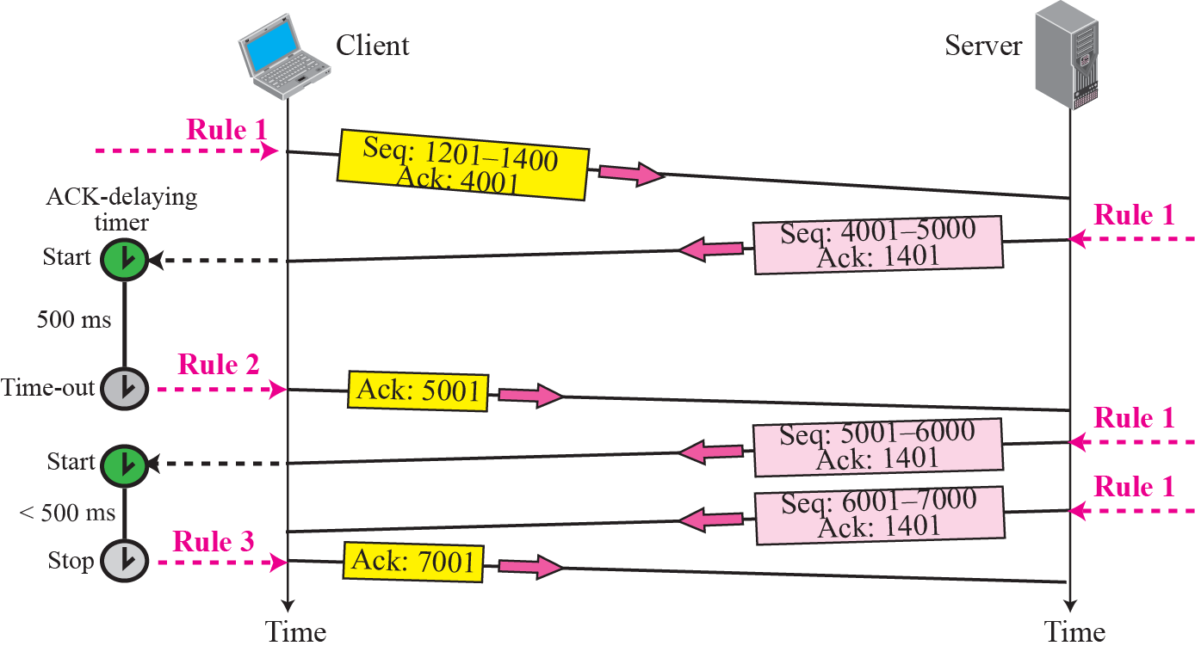
Figure 15.29 Normal operation

Slide 39
Lost Segment
A lost or corrupted segment is treated the same way by the receiver.
A lost segment is discarded somewhere in the network; a corrupted segment is discarded by the receiver itself. Both are considered lost.
sender sends segments 1 and 2, which are acknowledged immediately by an ACK (rule 3).
Segment 3, however, is lost. The receiver receives segment 4, which is out of order.
The receiver stores the data in the segment in its buffer but leaves a gap to indicate that there is no continuity in the data.
Receiver immediately sends an acknowledgment to the sender displaying the next byte it expects (rule 4).
receiver stores bytes 801 to 900, but never delivers these bytes to the application until the gap is filled.
Sender TCP keeps one RTO timer for whole period of connection. When third segment times out, sending TCP resends segment 3, which arrives this time and is acknowledged properly (rule 5).

Slide 40
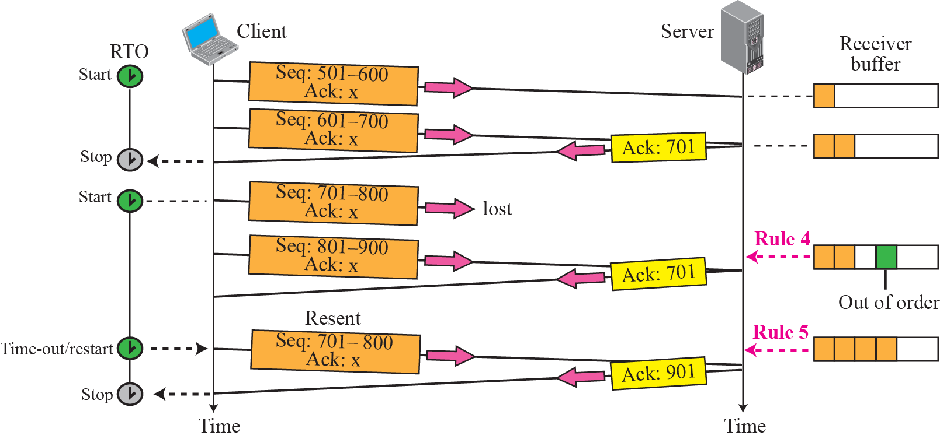
Figure 15.30 Lost segment

Slide 41
Note
The receiver TCP delivers only ordered data to the process.

Slide 42
Fast Retransmission
Scenario is the same as second except that RTO has a larger value (Figure 15.31).
Each time the receiver receives the fourth, fifth, and sixth segments, it triggers an acknowledgment (rule 4).
Sender receives 4 acknowledgments with the same value (3 duplicates).
Although timer has not matured, rule for fast transmission requires that segment 3, that is expected by all of these duplicate acknowledgments, be resent immediately.
After resending this segment, the timer is restarted.

Slide 43
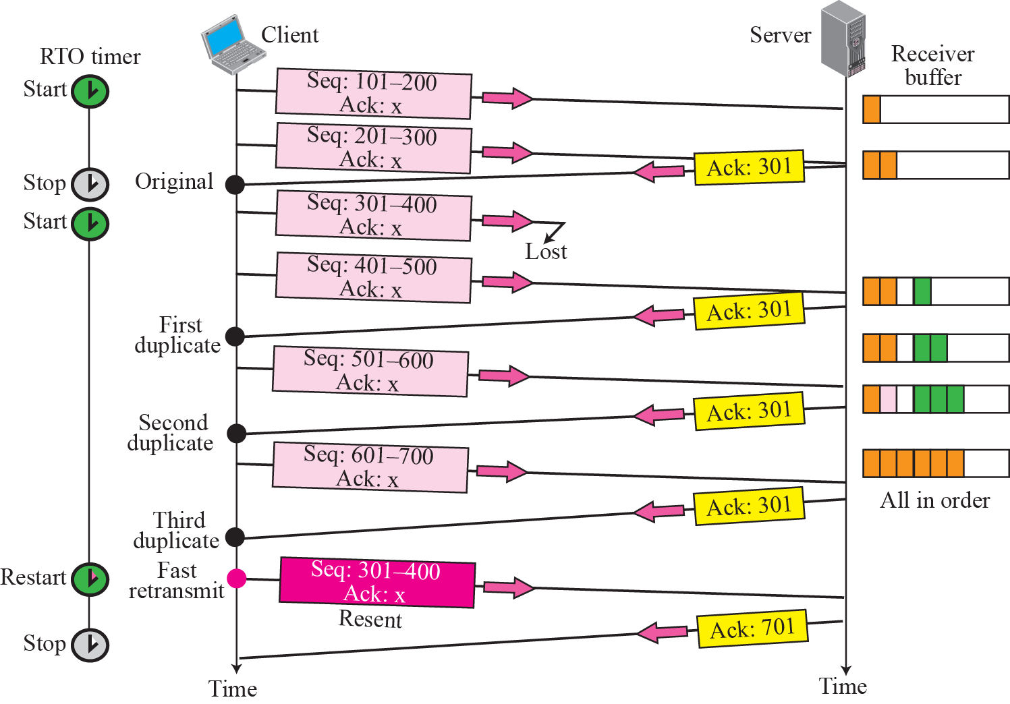





Figure 15.31 Fast retransmission

Slide 44
Delayed Segment
TCP uses the services of IP, which is a connectionless protocol.
Each IP datagram encapsulating a TCP segment may reach the final destination through a different route with a different delay.
Hence TCP segments may be delayed.
Delayed segments sometimes may time out.
If the delayed segment arrives after it has been resent, it is considered a duplicate segment and discarded.

Slide 45
Duplicate Segment
Duplicate segment can be created, for example, by a sending TCP when a segment is delayed and treated as lost by the receiver.
Handling duplicated segment is a simple process for the destination TCP.
When a segment arrives that contains a sequence number equal to an already received and stored segment, it is discarded.
An ACK is sent with ackNo defining the expected segment.

Slide 46
Automatically Corrected Lost ACK
Situation in which information in lost acknowledgment is contained in the next one, a key advantage of using cumulative acknowledgments.
In the TCP acknowledgment mechanism, a lost acknowledgment may not even be noticed by the source TCP.
TCP uses an accumulative acknowledgment system.
The next acknowledgment automatically corrects the loss of acknowledgment.

Slide 47
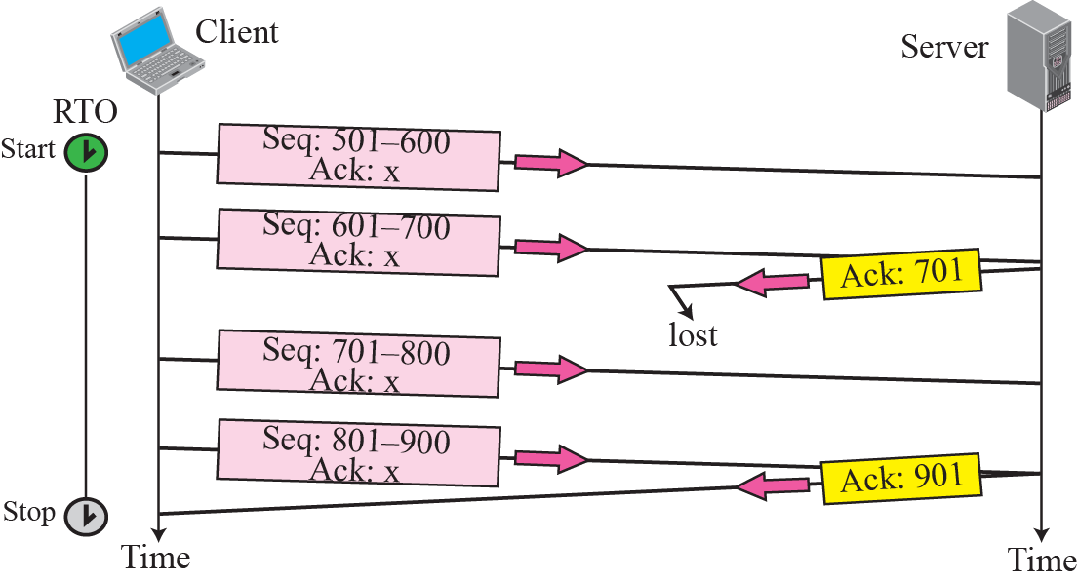
Figure 15.32 Lost acknowledgment

Slide 48
Lost Acknowledgment Corrected by Resending a Segment
Figure 15.33 shows a scenario in which an acknowledgment is lost.
If the next acknowledgment is delayed for a long time or there is no next acknowledgment, the correction is triggered by the RTO timer.
A duplicate segment is the result.
When receiver receives a duplicate segment, it discards it, and resends last ACK immediately to inform the sender that segment(s) have been received.
Note that only one segment is retransmitted although two segments are not acknowledged.
When the sender receives the retransmitted ACK, it knows that both segments are safe and sound because acknowledgment is cumulative.

Slide 49
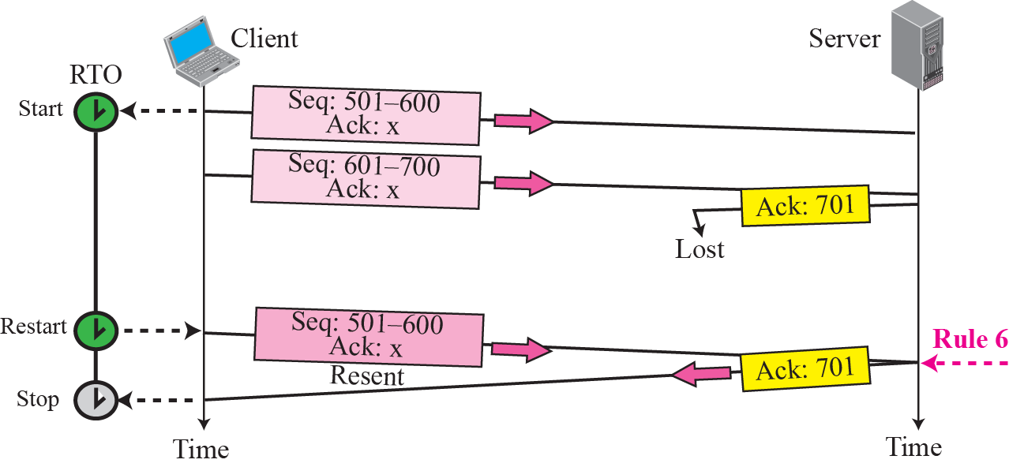
Figure 15.33 Lost acknowledgment corrected by resending a segment

Slide 50
Deadlock Created by Lost Acknowledgment
loss of an acknowledgment may result in system deadlock.
This is the case in which a receiver sends an acknowledgment with rwnd set to 0
and requests that the sender shut down its window temporarily.
After a while, the receiver wants to remove the restriction; however, if it has no data to send, it sends an ACK segment and removes the restriction with a nonzero value for rwnd.
A problem arises if this acknowledgment is lost.
The sender is waiting for an acknowledgment that announces the nonzero rwnd.
This situation is called a deadlock; each end is waiting for a response from the other end and nothing is happening. A retransmission timer is not set.
To prevent deadlock, a persistence timer was designed.

Slide 51
15-9 CONGESTION CONTROL
TCP uses a congestion window and a congestion policy that avoid congestion and detect and alleviate congestion after it has occurred.

Slide 52

Congestion Window
We said that sender window size is determined by available buffer space in the receiver (rwnd).
We assumed that it is only the receiver that can dictate to the sender the size of the sender’s window.
We totally ignored another entity here, the network.
If the network cannot deliver data as fast as it is created by the sender, it must tell the sender to slow down.
In addition to receiver, network is a second entity that determines size of the sender’s window.
Sender has 2 pieces of information: receiver-advertised window size and the congestion window size. The actual size of window is the minimum of these two.

Slide 53
Congestion Policy
TCP’s general policy for handling congestion is based on 3 phases:
slow start,
congestion avoidance, and
congestion detection.
In slow start phase, sender starts with a slow rate of transmission, but increases the rate rapidly to reach a threshold.
When the threshold is reached, the rate of increase is reduced.
Finally if ever congestion is detected, sender goes back to the slow start or congestion avoidance phase, based on how the congestion is detected.

Slide 54
Slow Start: Exponential Increase
slow start algorithm is based on the idea that the size of the congestion window (cwnd) starts with one maximum segment size (MSS).
MSS is determined during connection establishment.
Size of the window increases one MSS each time one acknowledgement arrives.
The algorithm starts slowly, but grows exponentially.
Here assumed that rwnd is much longer than cwnd, so that the sender window size always equals cwnd.
For simplicity, we ignore delayed-ACK policy and assume that each segment is acknowledged individually.

Slide 55
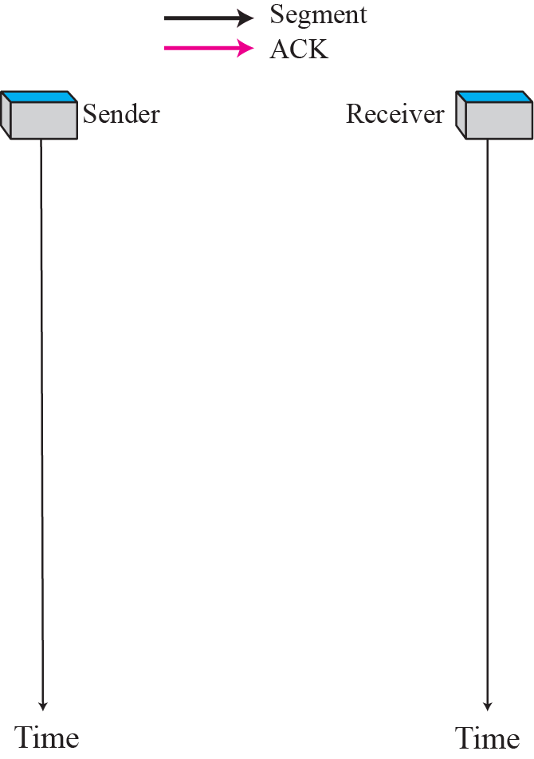
Figure 15.34 Slow start, exponential increase

Slide 56
The sender starts with cwnd = 1 MSS.
This means that sender can send only one segment.
After the first ACK arrives, the size of the congestion window is increased by 1, which means that cwnd is now 2. Now two more segments can be sent.
When two more ACKs arrive, the size of the window is increased by 1 MSS for each ACK, which means cwnd is now 4.
Now four more segments can be sent. When four ACKs arrive, the size of the window increases by 4, which means that cwnd is now 8.

Slide 57

slow start strategy is slower in the case of delayed acknowledgments.
For each ACK, cwnd is increased by only 1 MSS. If 3 segments are acknowledged accummlatively, size of the cwnd increases by only 1 MSS, not 3 MSS. Growth is still exponential, but it is not a power of 2. With 1 ACK for every 2 segments, power is closer to 1.5.
Slow start cannot continue indefinitely. There must be a threshold to stop this phase.
The sender keeps track of a variable named ssthresh (slow start threshold).
When size of window in bytes reaches this threshold, slow start stops and the next phase starts.

Slide 58
Note
In the slow start algorithm, the size of the congestion window increases exponentially until it reaches a threshold.

Slide 59
Congestion Avoidance: Additive Increase
If we start with the slow start algorithm, the size of the congestion window increases exponentially.
To avoid congestion before it happens, one must slow down this exponential growth.
TCP defines another algorithm called congestion avoidance, which increases the cwnd additively instead of exponentially.

Slide 60
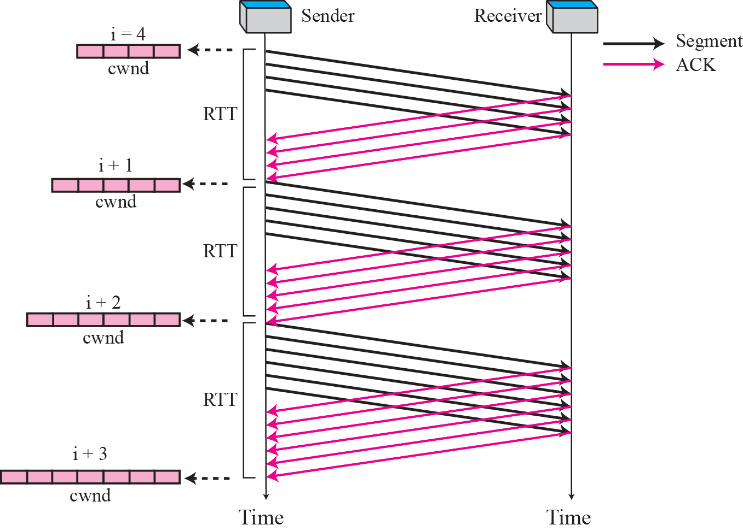
Figure 15.35 Congestion avoidance, additive increase

Slide 61
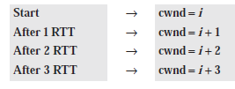
When the size of the congestion window reaches the slow start threshold in the case where cwnd = i, the slow start phase stops and the additive phase begins.
In this, each time the whole “window” of segments is acknowledged, the size of congestion window is increased by one.
The increase is based on RTT, not on the number of arrived ACKs.
If we look at the size of cwnd in terms of round-trip time (RTT), we find that the rate is additive as shown below:

Slide 62
Note
In the congestion avoidance algorithm the size of the congestion window
increases additively until
congestion is detected.

Slide 63
Congestion Detection: Multiplicative Decrease
If congestion occurs, the congestion window size must be decreased.
The only way a sender can guess that congestion has occurred is the need to retransmit a segment. This is a major assumption made by TCP.
Retransmission is needed to recover a missing packet which is assumed to have been dropped by a router that had so many incoming packets, that had to drop the missing segment, i.e., the router/network became overloaded or congested.
Retransmission can occur in one of two cases:
when the RTO timer times out or
when three duplicate ACKs are received.
In both cases, size of the threshold is dropped to half (multiplicative decrease).

Slide 64
Most TCP implementations have two reactions:
1. If a time-out occurs, there is a stronger possibility of congestion; a segment has probably been dropped in the network and there is no news about sent segments. In this case TCP reacts strongly:
a. It sets the value of the threshold to half of the current window size.
b. It reduces cwnd back to one segment.
c. It starts the slow start phase again.
2. If three duplicate ACKs are received, there is a weaker possibility of congestion; a segment may have been dropped but some segments after that have arrived safely since three duplicate ACKs are received. This is called fast transmission and fast recovery. In this case, TCP has a weaker reaction as shown below:
a. It sets the value of the threshold to half of the current window size.
b. It sets cwnd to the value of the threshold.
c. It starts the congestion avoidance phase.

Slide 65
Summary
Figure summarize congestion policy of TCP and relationships between 3 phases.
We give an example in Figure 15.37.
Here assumed that the maximum window size is initially 32 segments.
The threshold is initially set to 16 segments (half of the maximum window size).
In the slow start phase the window size starts from 1 and grows exponentially until it reaches the threshold. After reaching the threshold, the congestion avoidance (additive increase) procedure allows the window size to increase linearly until a time-out occurs or the maximum window size is reached.

Slide 66
Summary
In the figure, a time-out occurs when the window size is 20.
At this moment, multiplicative decrease procedure takes over and reduces threshold to half of the window size. Window size was 20 when the time-out happened so the new threshold is now 10.
TCP moves to slow start again and starts with a window size of 1, and moves to additive increase when the new threshold is reached.
When the window size is 12, a three- ACKs event happens.
The multiplicative decrease procedure takes over again.
The threshold and window size set to 6 and TCP enters the additive increase phase this time.
TCP remains in this phase until another time-out or another three-ACKs event happens.

Slide 67
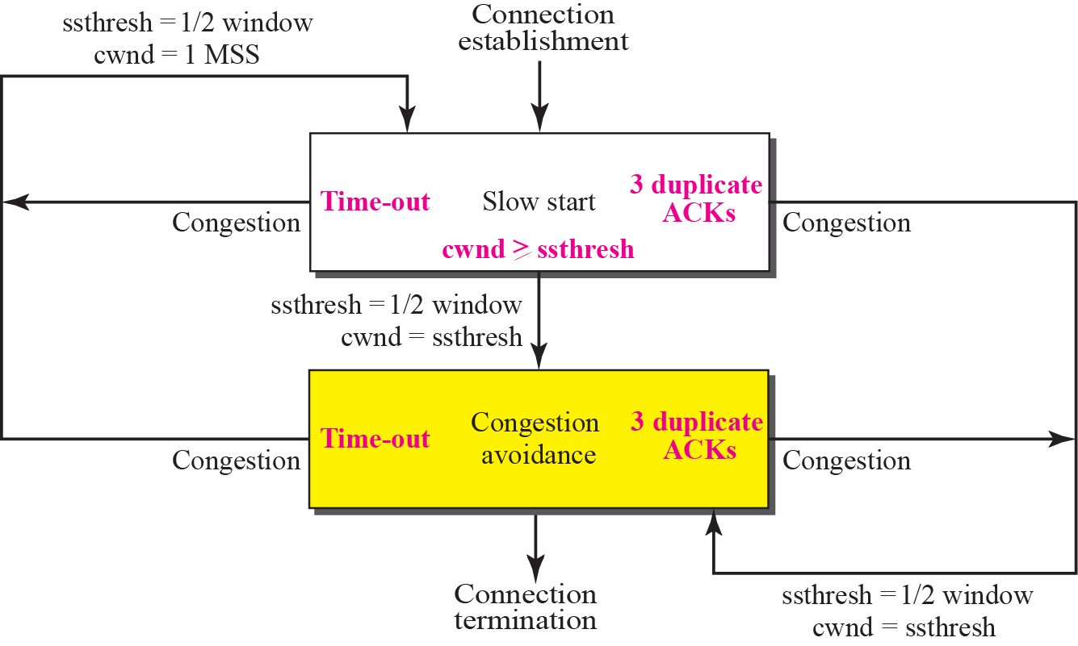
Figure 15.36 TCP Congestion policy summary

Slide 68
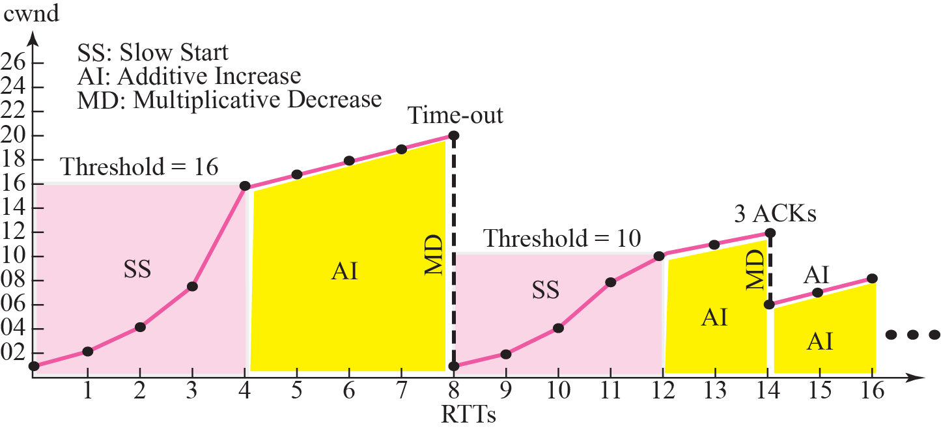
Figure 15.37 Congestion example
Maximum window size :32

Slide 69
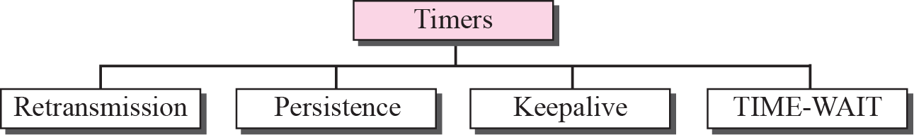
15-10 TCP TIMERS
To perform operation smoothly, most TCP implementations use at least four timers.

Slide 70
Figure 15.38 TCP timers
Retransmission Timer
To retransmit lost segments, TCP employs one retransmission timer that handles the retransmission time-out (RTO), the waiting time for an acknowledgment of a segment.
Following are rules for the retransmission timer:
When TCP sends the segment in front of the sending queue, it starts the timer.
2. When the timer expires, TCP resends the first segment in front of the queue, and restarts the timer.
3. When a segment (or segments) are cumulatively acknowledged, the segment (or segments) are purged from the queue.
4. If the queue is empty, TCP stops the timer; otherwise, TCP restarts the timer.

Slide 71
Persistence Timer
To deal with a zero-window-size advertisement, TCP needs another timer.
If the receiving TCP announces a window size of zero, sending TCP stops transmitting segments until the receiving TCP sends an ACK segment announcing a nonzero window size.
This ACK segment can be lost.
The sending TCP has not received an acknowledgment and waits for the other TCP to send an acknowledgment advertising the size of the window.
Both TCPs might continue to wait for each other forever (a deadlock).

Slide 72
Persistence Timer (contd)
To correct this deadlock, TCP uses a persistence timer for each connection.
When the sending TCP receives an acknowledgment with a window size of zero, it starts a persistence timer.
When the persistence timer goes off, the sending TCP sends a special segment called a probe.
The probe causes the receiving TCP to resend the acknowledgment.
If a response is not received from the receiver, another probe segment is sent and the value of persistence timer is doubled and reset.
Sender continues sending the probe segments and doubling and resetting the value of the persistence timer until the value reaches a threshold (usually 60 s).
After that the sender sends one probe segment every 60 s until the window is reopened.

Slide 73
Keepalive Timer
A keepalive timer is used to prevent a long idle connection between two TCPs.
Suppose that a client opens a TCP connection to a server, transfers some data, and becomes silent.
Perhaps the client has crashed. In this case, the connection remains open forever.
To remedy this situation, most implementations equip a server with a keepalive timer.
Each time the server hears from a client, it resets this timer.
The time-out is usually 2 hours. If the server does not hear from the client after 2 hours, it sends a probe segment.
If there is no response after 10 probes, it assumes that client is down and terminates the connection.

Slide 74
TIME-WAIT Timer
The TIME-WAIT (2MSL) timer is used during connection termination.

Slide 75
END

